Slide 1
HPX
A C++ Standard Library for Parallelism and Concurrency
Make C++ Parallelism Independent of any External Solutions by 2020

Slide 2
Companions Left Behind
Parallelism in (standard) C++ today depends on external solutions
Pragma based solutions
OpenMP
OpenACC
External Libraries (mostly ‘C’ libraries)
CUDA
MPI
TBB, PPL (C++)
Insufficient integration with
C++ type system and
C++ standard libraries
Insufficient integration between those solutions

Slide 3
Types of Parallelism
Data parallelism
Iterative fork/join
#pragma omp parallel for, very limited, not integrated with type system
Accelerators, coprocessors
OpenACC, various library solutions
Task based asynchronous and continuation style parallelism
Fork/join of heterogeneous tasks
OpenMP tasks, difficult to compose, difficult to nest
Task-based parallelism
OpenMP tasks, very limited as they can’t exit current scope
TBB, weakly aligned with C++ Standard library, tasks can’t suspend
Asynchronous continuation style
???

Slide 4
Types of Parallelism
Instruction Level Parallelism
Vectorization, SIMD instructions
#pragma simd
Distributed computing
MPI, mostly data transfer, coarse grain coordination (barriers)
Difficult to use in conjunction with any of the above

Slide 5
Status of Parallelism in C++
Current state of standard C++:
Parallelism TS: iterative parallelism (moved to be included into C++17)
Concurrency TS: task-based, asynchronous, and continuation style parallelism
N4411: task blocks for fork-join parallelism of heterogeneous tasks
N4406, PR0008R0: executors
PR0057R0: resumable functions (co_await, etc.)
Missing:
Integration of the above
Parallel ranges
Vectorization is being discussed
Extensions for GPUs, many-core, distributed, and high-performance computing
The goal has to be to make parallelism in C++ independent of any external solutions such as OpenMP, OpenACC, etc.
HPX makes C++ independent of MPI as well

Slide 6
Controlling What?
Where and when of execution of code
What compute resource to use?
In what sequence to execute things?
What type of parallelism to apply?
What restrictions apply to code
Can run concurrently, must run sequentially, can be vectorized, etc.
What additional parameters to apply
Grainsize of execution (chunking of loop iterations)

Slide 7
Concepts and Types of Parallelism
Application
Parallel Algorithms
Fork-Join
Asynchronous
Restrictions
Futures, Async, Dataflow
Concepts
Sequence,
Where
Execution Policies
Grainsize
Executors…
Executor Parameters…

Slide 8
HPX
The C++ Standards Library for Concurrency and Parallelism

Slide 9
HPX – A General Purpose Runtime System
General purpose parallel runtime system for applications of any scale
Exposes a coherent and uniform, standards-oriented API for ease of programming parallel, distributed, and heterogeneous applications.
Enables to write fully asynchronous code using hundreds of millions of threads.
Provides unified syntax and semantics for local and remote operations.
HPX represents an innovative mixture of
A global system-wide address space (AGAS - Active Global Address Space)
Fine grain parallelism and lightweight synchronization
Combined with implicit, work queue based, message driven computation
Full semantic equivalence of local and remote execution, and
Explicit support for hardware accelerators (through percolation)

Slide 10
HPX – A General Purpose Runtime System
Enables writing applications which out-perform and out-scale existing applications based on OpenMP/MPI
http://stellar-group.org/libraries/hpx
https://github.com/STEllAR-GROUP/hpx/
Is published under Boost license and has an open, active, and thriving developer community.
Can be used as a platform for research and experimentation

Slide 11
HPX – The API
As close as possible to C++11/14/17 standard library, where appropriate, for instance
std::thread hpx::thread
std::mutex hpx::mutex
std::future hpx::future (including N4538, ‘Concurrency TS’)
std::async hpx::async (including N3632)
std::bind hpx::bind
std::function hpx::function
std::tuple hpx::tuple
std::any hpx::any (N3508)
std::cout hpx::cout
std::parallel::for_each, etc. hpx::parallel::for_each (N4507, ‘Parallelism TS’)
std::parallel::task_region hpx::parallel::task_region (N4411)

Slide 12
Parallel Algorithms

Slide 13
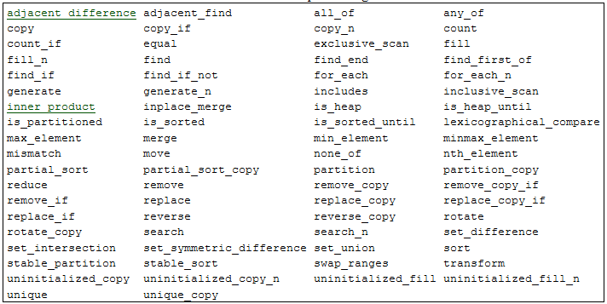
Parallel Algorithms

Slide 14
Parallel Algorithms
Similar to standard library facilities known for years
Add execution policy as first argument
Execution policies have associated default executor and default executor parameters
par → parallel executor, static chunk size
seq → sequential executor, no chunking
Rebind executor and executor parameters:
// // Simplest case: parallel execution policy // std::vector<double> d(1000); parallel::fill( par, begin(d), end(d), 0.0);

Slide 15
Execution Policies (HPX Extensions)
Extensions: asynchronous execution policies
parallel_task_execution_policy (asynchronous version of parallel_execution_policy), generated with par(task)
sequential_task_execution_policy (asynchronous version of sequential_execution_policy), generated with seq(task)
In all cases the formerly synchronous functions return a future<>
Instruct the parallel construct to be executed asynchronously
Allows integration with asynchronous control flow

Slide 16
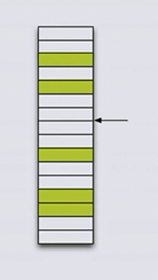
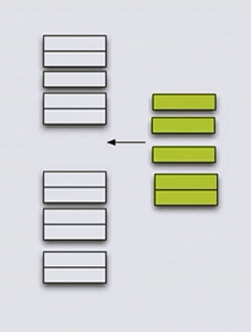
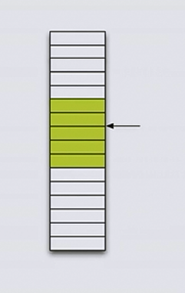
Extending Parallel Algorithms
Sean Parent: C++ Seasoning, Going Native 2013

Slide 17
Extending Parallel Algorithms
New algorithm: gather
template <typename BiIter, typename Pred>
pair<BiIter, BiIter> gather(BiIter f, BiIter l, BiIter p, Pred pred)
{
BiIter it1 = stable_partition(f, p, not1(pred));
BiIter it2 = stable_partition(p, l, pred);
return make_pair(it1, it2);
}
Sean Parent: C++ Seasoning, Going Native 2013

Slide 18
Extending Parallel Algorithms
New algorithm: gather_async
template <typename BiIter, typename Pred>
future<pair<BiIter, BiIter>> gather_async(BiIter f, BiIter l, BiIter p, Pred pred)
{
future<BiIter> f1 = parallel::stable_partition(par(task), f, p, not1(pred));
future<BiIter> f2 = parallel::stable_partition(par(task), p, l, pred);
return dataflow(
unwrapped([](BiIter r1, BiIter r2) { return make_pair(r1, r2); }),
f1, f2);
}

Slide 19
Extending Parallel Algorithms (await)
New algorithm: gather_async
template <typename BiIter, typename Pred>
future<pair<BiIter, BiIter>> gather_async(BiIter f, BiIter l, BiIter p, Pred pred)
{
future<BiIter> f1 = parallel::stable_partition(par(task), f, p, not1(pred));
future<BiIter> f2 = parallel::stable_partition(par(task), p, l, pred);
co_return make_pair(co_await f1, co_await f2);
}

Slide 20
Execution Policies (HPX Extensions)
Extensions: vectorization execution policies
datapar_task_execution_policy (asynchronous version of datapar_execution_policy), generated with datapar, datapar(task)
dataseq_task_execution_policy (asynchronous version of dataseq_execution_policy), generated with dataseq, dataseq(task)
Instruct the algorithm to apply certain transformations to used data types allowing for vectorization of code
Requires external library: currently Vc (https://github.com/VcDevel/Vc), possibly Boost.SIMD
Requires use of generic lambdas (C++14) or polymorphic function objects

Slide 21
Executors

Slide 22
Executors
Executors must implement one function: async_execute(F && f)
Invocation of executors happens through executor_traits which exposes (emulates) additional functionality:
executor_traits<my_executor_type>::execute(
my_executor,
[](...){ // perform task },
...);
Four modes of invocation: single async, single sync, bulk async and bulk sync
The async calls return a future

Slide 23
Executor Examples
sequential_executor, parallel_executor:
Default executors corresponding to par, seq
this_thread_executor
distribution_policy_executor
Use one of HPX’s (distributed) distribution policies, specify node(s) to run on
host::parallel_executor
Specify core(s) to run on (NUMA aware)
cuda::default_executor
Use for running things on GPU
Etc.

Slide 24
Executor Parameters (HPX Extension)
Same scheme as for executor/executor_traits:
parameter/executor_parameter_traits
Various execution parameters, possibly executor specific
For instance:
Allow to control the grain size of work
i.e. amount of iterations of a parallel for_each run on the same thread
Similar to OpenMP scheduling policies: static, guided, dynamic
auto_chunk_size, static_chunk_size, dynamic_chunk_size
Much more fine control
Used by parallel algorithms to adjust chunk size
Specify GPU-kernel name for certain platforms
gpu_kernel<foobar>
Specify which other arrays to prefetch

Slide 25
Parallel Algorithms
Similar to standard library facilities known for years
Add execution policy as first argument
Execution policies have associated default executor and default executor parameters
par → parallel executor, static chunk size
seq → sequential executor, no chunking
Rebind executor and executor parameters:
// // Simplest case: parallel execution policy // std::vector<double> d(1000); parallel::fill( par, begin(d), end(d), 0.0);

Slide 26
Parallel Algorithms
Similar to standard library facilities known for years
Add execution policy as first argument
Execution policies have associated default executor and default executor parameters
par → parallel executor, static chunk size
seq → sequential executor, no chunking
Rebind executor and executor parameters:
// rebind execution policy // .on(): executor object, ‘where and when’ // .with(): parameter object(s), possibly executor specific parameters std::vector<double> d(1000); parallel::fill( par.on(exec).with(par1, par2, ...), begin(d), end(d), 0.0);

Slide 27
Rebind Execution Policies
// uses default execution policy: par
std::vector<double> d = { ... };
parallel::fill(par, begin(d), end(d), 0.0);
// rebind par to user-defined executor
my_executor my_exec = ...;
parallel::fill(par.on(my_exec), begin(d), end(d), 0.0);
// rebind par to user-defined executor and user defined executor parameters
my_params my_par = ...
parallel::fill(par.on(my_exec).with(my_par), begin(d), end(d), 0.0);

Slide 28
Data placement

Slide 29
Data Placement
Different strategies for different platforms
Need interface to control explicit placement of data
NUMA architectures
GPUs
Distributed systems
Use std::allocator<T> interfaces
NUMA architectures: first touch
Slightly extended: bulk-operations for allocation, construction, destruction, and deallocation

Slide 30
Data Placement
HPX:
hpx::vector<T, Alloc>
Same interface as std::vector<T>
Manages data locality through allocator
Uses execution target objects for data placement
Allows for direct manipulation of data on NUMA domains, GPUs, remote nodes, etc.
hpx::partitioned_vector<T>
Same interface as std::vector<T>
Segmented data store
Segments can be hpx::vector<T, Alloc>
Uses distribution_policy for data placement
Allows for manipulation of data on several targets

Slide 31
Data Placement
Extending std::allocator_traits
Adding functionality to copy data
CPU: trivial
GPU: platform specific data transfer, hooked into parallel::copy
Distributed: maps onto network, possibly RDMA (put/get)
Adding functionality to access single elements
CPU: trivial
GPU: slow, but possible
Distributed: maps onto network

Slide 32
Execution Targets
One Ring to Rule them All

Slide 33
Execution Targets
Opaque types which represent a place in the system
Used to identify data placement
Used to specify execution site close to data
Targets encapsulate architecture specifics
E.g. cuda::target, host::target
Allocators to be initialized from targets
Customization of data placement
NUMA domain: host::block_allocator
(possibly remote) GPU device: cuda::allocator
Locality, i.e. (possibly remote) node
Executors to be initialized from targets as well
Make sure code is executed close to placed data

Slide 34
Examples
Tying it all together

Slide 35
STREAM Benchmark
Assess memory bandwidth
Series of parallel for loops, 3 arrays (a, b, c)
copy step: c = a
scale step: b = k * c
add two arrays: c = a + b
triad step: a = b + k * c
Best possible performance possible only if data is placed properly
Data has to be located in memory of NUMA-domain where thread runs
OpenMP: implicitly by using ‘first touch’, i.e. run initialization and actual benchmark using same thread
#pragma omp parallel for schedule(static)

Slide 36
STREAM Benchmark
std::vector<double> a, b, c; // data
// ... init data
auto a_begin = a.begin(), a_end = a.end(), b_begin = b.begin() ...;
// STREAM benchmark
parallel::copy(par, a_begin, a_end, c_begin); // copy step: c = a
parallel::transform(par, c_begin, c_end, b_begin, // scale step: b = k * c
[](double val) { return 3.0 * val; });
parallel::transform(par, a_begin, a_end, b_begin, b_end, c_begin, // add two arrays: c = a + b
[](double val1, double val2) { return val1 + val2; });
parallel::transform(par, b_begin, b_end, c_begin, c_end, a_begin, // triad step: a = b + k * c
[](double val1, double val2) { return val1 + 3.0 * val2; });

Slide 37
STREAM Benchmark (CPU)
host::target tgt("numa=0"); // where and when, here CPU, NUMA domain 0
using executor = host::parallel_executor;
using allocator = host::block_allocator<double>;
executor exec(tgt); // define execution site
allocator alloc(tgt, ...); // define data placement
vector<double, allocator> a(alloc), b(alloc), c(alloc); // data
// ... init data
auto policy = par.on(exec).with(static_chunk_size()); // bound execution policy
// STREAM benchmark
parallel::copy(policy, a_begin, a_end, c_begin);
// ...

Slide 38
STREAM Benchmark: HPX vs. OpenMP

Slide 39
Extending to GPUs

Slide 40
STREAM Benchmark (GPU)
cuda::target target("Tesla C2050"); // where and when, here NVidia GPU (CUDA)
using executor = cuda::default_executor;
using allocator = cuda::allocator<double>;
executor exec(tgt); // define execution site
allocator alloc(tgt); // define data placement
std::vector<double> data = { ... }; // init data on host
hpx::vector<double, allocator> a(alloc), b(alloc), c(alloc); // data on device
parallel::copy(par, data.begin(), data.end(), a_begin); // copy data to device
// STREAM benchmark
// ...

Slide 41
STREAM Benchmark: HPX vs. OpenCL

Slide 42
Vectorization

Slide 43
Dot-product: Parallel Execution
std::vector<float> data1 = {...};
std::vector<float> data2 = {...};
inner_product(
par, // just parallel execution
std::begin(data1), std::end(data1),
std::begin(data2),
0.0f,
[](auto t1, auto t2) { return t1 + t2; }, // std::plus<>()
[](auto t1, auto t2) { return t1 * t2; } // std::multiplies<>()
);

Slide 44
Dot-product: Vectorization
std::vector<float> data1 = {...};
std::vector<float> data2 = {...};
inner_product(
datapar, // parallel and vectorized execution
std::begin(data1), std::end(data1),
std::begin(data2),
0.0f,
[](auto t1, auto t2) { return t1 + t2; }, // std::plus<>()
[](auto t1, auto t2) { return t1 * t2; } // std::multiplies<>()
);

Slide 45
Dot-Product: Results

Slide 46
